Slide 1
Introduction to Java
ICS 2 – Introduction to Computer Programming

Slide 2
Brief History of Java
Earlier called Oak Programming Language
Created by James Gosling of Sun Microsystems
Later called Java due to copyright reasons
Platform independent language
Notes:
Mike Sheridan, Patrick Naughton
1991 – started development
1995 – release of Java
Platform independent – crosss platform
Java SE, Java ME, Java EE

Slide 3
Java Technology
Programming Language
Can generate all kinds of application
Development Environment
Provides developer tools
Application Environment
Can run on a machine where JRE is installed
Deployment Environment
SDK contains complete set of class files for all types of Java technology packages
Notes:
PL – communication tool between the human and the machine
Java SE, Java ME, Java EE
DE – JDK

Slide 4
Features of Java
Java Virtual Machine (JVM)
An imaginary machine used to emulate software on a real machine
Garbage Collection
Responsible for deallocating memory previously allocated by a programmer
Code Security
Class loader loads needed classes
Byte code verifier tests the format of the code
Code is executed

Slide 5
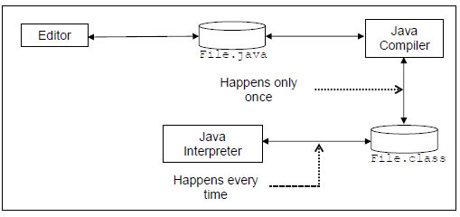
Phases of a Java Program

Slide 6
Compiling and Executing a Program
Compiling
The process of converting a source code into a machine readable format (class)
Executing
The process of running the program to see the output of that program

Slide 7
Types of Errors
Syntax Errors
Errors in form (syntax)
Inadvertently committed while typing the source code
Checked and reported by the compiler
Run-Time Error
Errors in meaning (semantics)
Sometimes referred to as Logical Errors

Slide 8
Java Programming Construct
class Declaration
public class <class_name> {
statements…
}

Slide 9
main( ) method
public static void main(String[ ] args) {
statements….
}

Slide 10
Comments
Used to document a part of the code.
Not part of the program itself and is only used for documentation purposes
Types:
Single line comment – denoted by the symbol //
Multi-line comment – enclosed in symbols /* … */

Slide 11
Printing Elements on Screen
Java uses System.out.print/ln( ) method to display elements on screen.
System.out.println – displays elements contained on its parameter per line
System.out.print - – displays elements contained on its parameter on a single line

Slide 12

Java Statement Blocks
Statement
Also called instruction is one or more lines of codes terminated by a semicolon
Block
One or more statements bound by an open and close curly brace

Slide 13
Java Identifiers
Also called tokens
Usually a user defined name that represent labels of variables, methods, and classes
Identifiers are case sensitive, it should be used the way it was written
Cannot be any of the reserved words used in Java

Slide 14
Conventions in Declaring Variables
Names are made up of letters and numbers
The first character should always start with a letter
Java is case sensitive
The underscore symbol _ and dollar sign $ are considered letters in Java but not recommended to be used as a first character in a name

Slide 15
Java Coding Conventions
For names of classes, capitalize the first letter of the class name
For method and variable names, the first letter of the word should start with a small letter
For multi-word identifiers, capitalize the first letter of each word except the first word

Slide 16
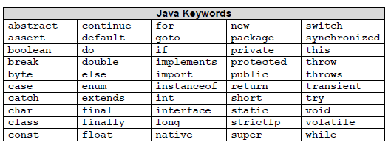
Java Keywords
Keywords are predefined identifiers reserved by Java for a specific purpose.
Cannot be used as identifiers

Slide 17
Java Literals and Constants
Integer Literals
Can be represented in decimal (base 10), hexadecimal (base 16) and octal (base 8) number systems
Examples:
12 (decimal)
0xC (hexadecimal)
014 (octal)
Floating Point Literals
Represent decimals with fractional part
Examples
3.1416
5.8234e2

Slide 18
Boolean Literals
Only have two values, true (1) or false (0)
Character Literals
Represents a single Unicode symbol
Should be enclosed in single quote delimiter
Example:
‘a’ Letter a
‘z’ Letter z
‘\n’ new line character

Slide 19
String Literals
Represents multiple characters and are enclosed by double quotes
Example:
“Hello World”
“Java Programming”

Slide 20
Primitive Data Types
Determine the range a certain variable can hold and set of operations that are defined for values of this type
It specifies:
The kind of values that can be assumed by a variable of that type
The range of values that can be assumed by a variable of that type
The amount of memory needed by a variable to store a value of that type

Slide 21
Types of Primitive Data Types
Logical – boolean
Stores only two values; either “true” or “false”
Example:
boolean state = true;
Boolean value;
Textual – char
Represents a single Unicode character
Example:
char letter = ‘A’;
char choice;

Slide 22
Integral – byte, short, int and long
Uses three forms – decimal, octal or hexadecimal
Default type is int, but can also be defined as byte, long or short
Difference between the types lies on the length of values it can store
Example
byte no = 10;
int number = 500
short x;
long z;

Slide 23
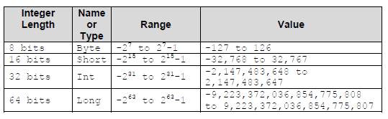
Integral Data Type Range

Slide 24
Floating Point – float and double
Used as a data type that stores and processes number with decimal places or contains either one of the following:
E or e - exponential value
F or f - float
D or d - double
Example:
float pi = 3.1416;
double decimal = 123456.73e10D;

Slide 25

Floating point types and ranges

Slide 26
String Class
Contains a series or multiple characters whose literal is enclosed in double quotes
Not a primitive data type but a reference type
Example:
String subject = “CCS.1101”;
String college = “CITCS”;
String name;

Slide 27
Program Variables
Entities where data can be stored to
Values stored can change anytime
Characteristics:
Name – referred to as identifier
Address – portion of RAM allocated
Value – content of the memory cell
Data Type – range of values it can store
Lifetime – time at which the variable is bound to a specific memory location
Scope – declaration until termination

Slide 28
Declaring and Initializing Variables
Syntax:
<data type> <name> [=<initial value>];
Values enclosed in <> are required while those inside[ ] are optional.

